Slide 1

COP 6731: Theory and Implementation of Database Systems
Query Processing and Optimization

Slide 2
Outline
Goal:
Understand the basic concept of query optimization
Query Block
Relation Algebra / Query Tree
Selectivity
Selection
Join and Cost Model
Projection / Set operations

Slide 3
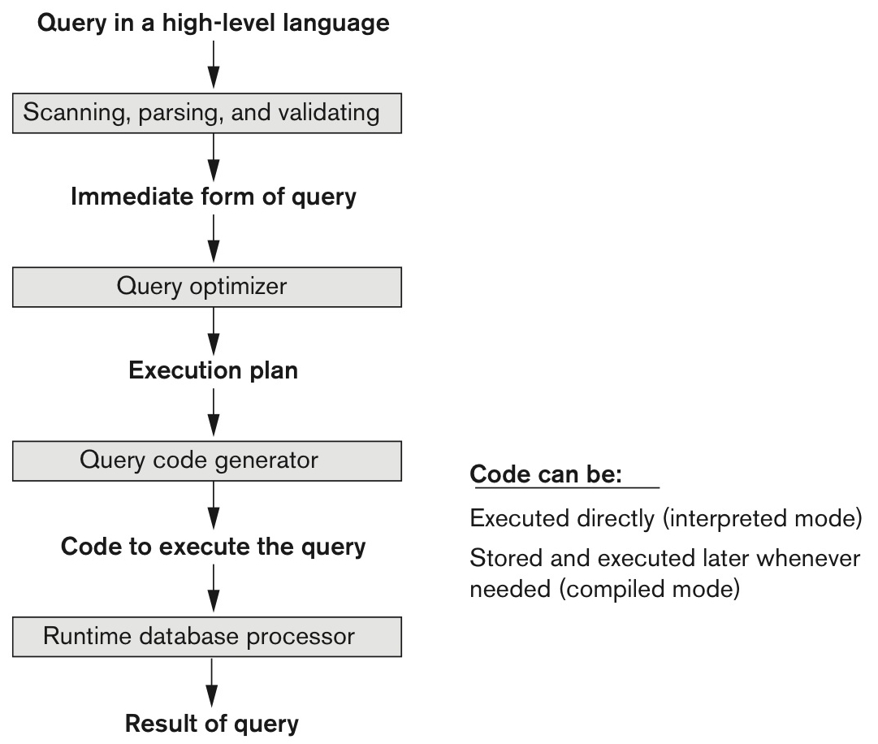
Processing High-level Query

Slide 4
Processing High-level Query
The aims of query processing are to transform a query written in a high-level language, typically SQL, into a correct and efficient execution strategy expressed in a low-level language (implementing relational algebra), and to execute the strategy to retrieve the required data
SQL
Relation Algebra
(Query Tree)
Query Optimization

Slide 5
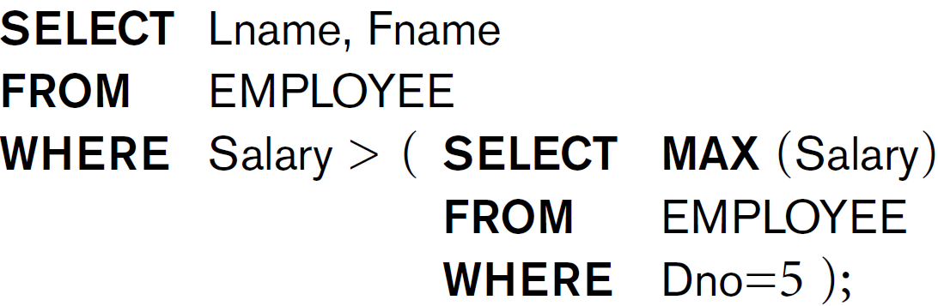
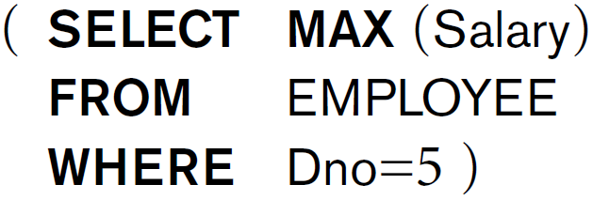

Query Block
SQL queries are decomposed into query blocks.

Slide 6
Storage and Access Methods

Slide 7
Algorithm for SELECT operation
σ_{<selection condition>} Relation
Linear Search (Brute Force Algorithm)
Retrieve all records and test whether its attribute values satisfy the selection condition.
Binary Search
Hash key
If the selection condition involves equality comparison (i.e., point query) on key attribute with hash key, then use the hash key to retrieve the records.
B+ tree
Use the index key to retrieve a single record (e.g., point query) or multiple records (e.g., range query).

Slide 8
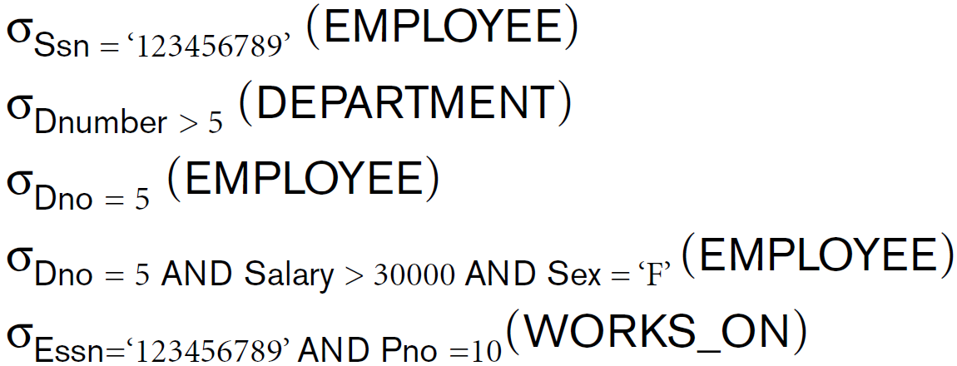
Example of SELECT operations

Slide 9
Search Methods for Conjunctive Selection
σ<selection condition 1 AND selection condition 2 AND ….> Relation
σDno=5 AND salary > 30000 AND age > 25 EMPLOYEE
Using individual index
ex) {Dno} or {salary} or {age}
Using composite index
ex) {Dno, salary, age}

Slide 10
Basic concept
Given relation R,
Cardinality: number of tuples (or rows).
The number of blocks to store r into storage.
Blocking factor (bfr): number of tuples per block.
Given relation R and select operation o (i.e., σ),
Selective (sl):
(the number of tuples with o) / (the total number of tuples in R)

Slide 11
Basic concept
Given EMPLOYEE(ssn, name, salary),
max(salary) = $50,000, and
min(salary) = $10,000,
assume that the records are evenly (or uniformly) distributed with salary attribute.
Selectivity
σ_{salary = 30,000} EMPLOYEE = 1/40,000
σ_{salary > 30,000} EMPLOYEE = 20,000/40,000 = 1/2

Slide 12

Algorithm for Join Operation
R ⋈_{A=B} S
A nested loop join is a naive algorithm that joins two sets by using two nested loops.

Slide 13
Join: Nested Loops
foreach tuple r in R do
foreach tuple s in S where r_{i} == s_{j} do
add <r, s> to result
R
S
r₁
s₁
r₂
s₂
r₃
s₃
r₄
s₄
r₅
s₅
Outer Table
Inner Table

Slide 14
Nested-loop Join
EMPLOYEE ⋈_{d_no=d_num} DEPARTMENT
EMPLOYEE
DEPARTMENT
ssn | name | d_no
s1 | James | d1
s2 | Robert | d2
s3 | Susan | d2
s4 | Jane | d1
s5 | George | d2
s6 | Charles | d2
s7 | Paul | d3
d_num | d_name
d1 | Finance
d2 | Sales
d3 | Research
Outer Table
Inner Table

Slide 15
Algorithm for Join Operation
R ⋈_{A=B} S
Block nested-loop join
Index nested-loop join
Sort merge join
Partition-hash join (or hash join)

Slide 16
Block nested-loop Join with 3 buffer pages
(R ⋈ _{r = s} S)
Assume that 3 buffer pages are available
for-each tuple r ∈ R do
for-each tuple s ∈ S do
if r_{i} == s_{j} in memory then add <r , s> to result

Slide 17
Block nested-loop Join with 3 buffer pages
(R ⋈ _{r = s} S)
R : m data blocks (or pages) with bfr_{R} blocking factor
S : n data blocks (or pages) with bfr_{S} blocking factor
for-each tuple r ∈ R do
for-each tuple s ∈ S do
if r_{i} == s_{j} in memory then add <r , s> to result
I/O cost : m + n · m

Slide 18
Block nested-loop Join with 3 buffer pages
Assume that we have three buffer caches and the blocking factor of both R and S is 2.
R
Buffer caches
S
EMPLOYEE
DEPARTMENT
ssn | name | d_no
s1 | James | d1
s4 | Jane | d1
s5 | George | d2
s6 | Charles | d2
d_num | d_name
d1 | Finance
d2 | Sales
d3 | Research
Block 1
Block 1
Block 2
Block 2
s2 | Robert | d2
s3 | Susan | d2
Block 3
Block 4
s7 | Paul | d3
Outer Table
Inner Table

Slide 19
Block nested-loop Join with b buffer pages
(R ⋈ _{r = s} S)
b buffer pages are available
for-each b-2 pages of R do
for-each page of S do
if r_{i} == s_{j} in memory, then add <r , s> to result

Slide 20
Block nested block Join with b buffer pages
(R ⋈ _{r = s} S)
b buffer pages
R : m data blocks (or pages) with bfr_{R} blocking factor
S : n data blocks (or pages) with bfr_{S} blocking factor
for-each b-2 pages of R do
for-each page of S do
if r_{i} == s_{j} in memory, then add <r , s> to result
I/O cost : m + n · m / (b-2)

Slide 21
Index nested-loop Join
(R ⋈ _{r = s} S)
EMPLOYEE ⋈_{d_no=d_num} DEPARTMENT
EMPLOYEE
DEPARTMENT
ssn | name | d_no
s1 | James | d1
s2 | Robert | d2
s3 | Susan | d2
s4 | Jane | d1
s5 | George | d2
s6 | Charles | d2
s7 | Paul | d3
d_num | d_name
d1 | Finance
d2 | Sales
d3 | Research
Index (d_num)
on Department
Outer Table
Inner Table

Slide 22
Index nested-loop Join
(R ⋈ _{r = s} S)
Assume that 2 buffer pages are available
for-each tuple r ∈ R do
for-each tuple s ∈ S, where r_{i} == s_{j}
add <r , s> to result

Slide 23
Index nested-loop Join
(R ⋈ _{r = s} S)
2 buffer pages are available
B+ tree (with index level l_{s} ) on S
R : m data blocks (or pages) with bfr_{R} blocking factor
S : n data blocks (or pages) with bfr_{S} blocking factor
for-each tuple r ∈ R do
for-each tuple s ∈ S, where r_{i} == s_{j}
add <r , s> to result
Assume that r has exactly one matching s on S
I/O cost : m + m · bfr_{R} · ( l_{s} + 1)
Assume that r has multiple matching s on S
I/O cost : m + m · bfr_{R} · ( l_{s} + # of matched tuples)

Slide 24
Sort-merge Join
(R ⋈ _{r = s} S)
EMPLOYEE
EMPLOYEE
ssn | name | d_no
s1 | James | d1
s2 | Robert | d2
s3 | Susan | d2
s4 | Jane | d1
s5 | George | d2
s6 | Charles | d2
s7 | Paul | d3
ssn | name | d_no
s1 | James | d1
s4 | Jane | d1
s5 | George | d2
s6 | Charles | d2
Sort
s2 | Robert | d2
s3 | Susan | d2
s7 | Paul | d3
DEPARTMENT
DEPARTMENT
d_num | d_name
d1 | Finance
d2 | Sales
d3 | Research
Sort
d_num | d_name
d1 | Finance
d2 | Sales
d3 | Research

Slide 25
Sort-merge Join
(R ⋈ _{r = s} S)
EMPLOYEE
DEPARTMENT
ssn | name | d_no
s1 | James | d1
s4 | Jane | d1
s5 | George | d2
s6 | Charles | d2
d_num | d_name
d1 | Finance
d2 | Sales
d3 | Research
s2 | Robert | d2
s3 | Susan | d2
s7 | Paul | d3
I/O cost : cost of sorting + m + n

Slide 26
Partition-hash Join
(R ⋈ _{r = s} S)
Partitioning Phase
R is partitioned into M partitions (R₁, R₂, … R_{M})
S is partitioned into M partitions (S₁, S₂, … S_{M})
Join (or Probing) Phase
Read each partition and join
Partitions with a hash function
R
⋈
S
I/O cost : 3 · ( m + n )

Slide 27
Algorithm for Project Operation
π_{<attribute list>}(R)
The result is a set of tuples. Duplicated are removed.
π_{salary} EMPLOYEE
SELECT DISTINCT salary
FROM EMPLOYEE
If <attribute list> does not include a key of R, duplicate must be eliminated.
Sorting
Hashing

Slide 28
Algorithm for Project Operation
π_{d_no} Employee
π_{d_no}
sorting
ssn | name | d_no
s1 | James | d1
s2 | Robert | d2
s3 | Susan | d2
s4 | Jane | d1
s5 | George | d2
s6 | Charles | d2
s7 | Paul | d3
d_no
d1
d2
d2
d1
d2
d2
d3
d_no
d1
d1
d2
d2
eliminate duplications
d_no
d1
d2
d3
d2
d2
d3

Slide 29
Algorithm for Project Operation
π_{d_no} Employee
π_{d_no}
partition using hash function
ssn | name | d_no
s1 | James | d1
s2 | Robert | d2
s3 | Susan | d2
s4 | Jane | d1
s5 | George | d2
s6 | Charles | d2
s7 | Paul | d3
d_no
d1
d2
d2
d1
d2
d2
d3
d1
d1
eliminate duplications
d_no
d1
d2
d3
d2
d2
d2
d2
d3

Slide 30
Algorithm for Set Operations
1) UNION (⋃)
2) INTERSECTION (∩)
3) SET DIFFERENCE (–)
4) CARTESIAN PRODUCT (✕)
Sorting
Hashing

Slide 31
Take home message
Query Block
Relation Algebra / Query Tree
Selectivity
Selection
Join and Cost Model
Projection / Set operations

